Slide 1
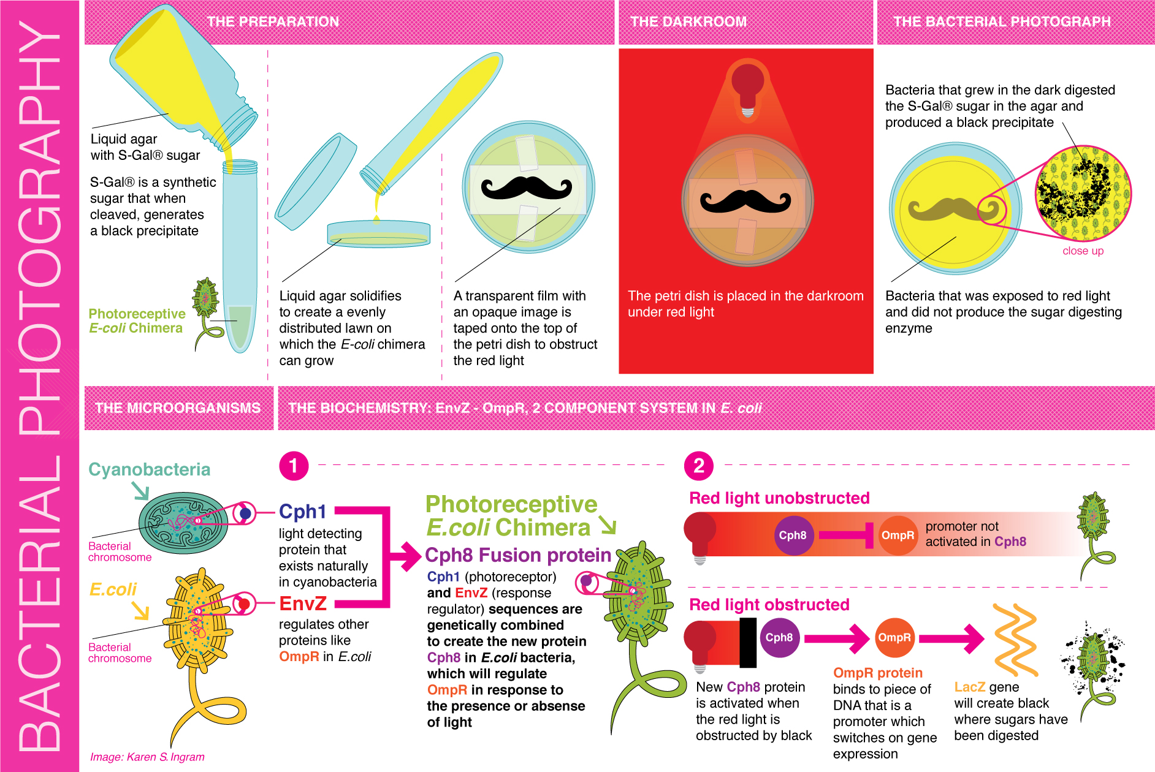

Slide 2
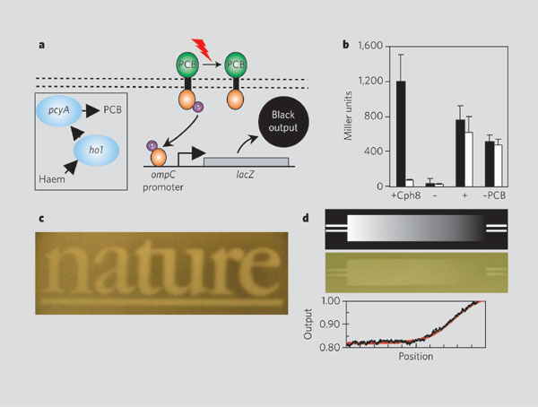
Fotografia bacteriana

Slide 3
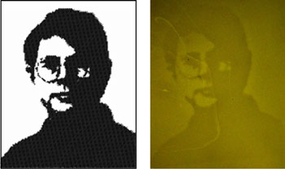
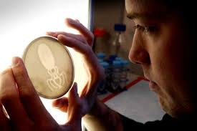
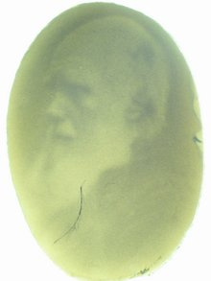
http://2006.igem.org/wiki/index.php/University_of_Texas_2006

Slide 4
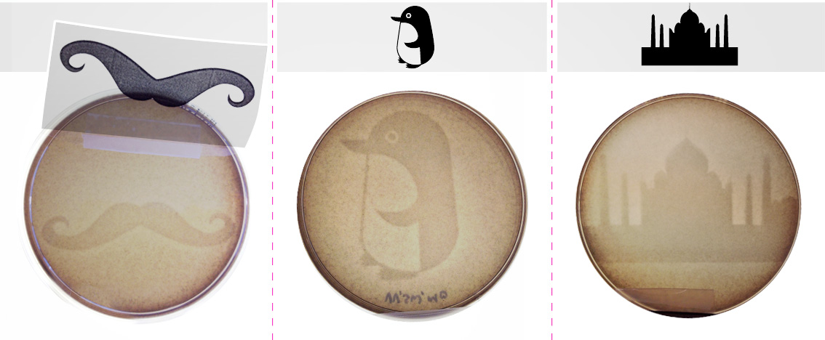
http://www.genspace.org/blog/2013/09/30/bacterial-photography-creating-photosynthetic-images-using-living-microorganisms/

